Slide 1
ENSC 474 Final Project

Slide 2
Image1
Original filename: 15_42_53-m3MM-MID_6_PR_avgOctVol_dB
Not very noisy and very healthy
Ideal to use to construct the function

Slide 3
Image2
Original filename: 18_45_10-_47_PR_avgOctVol_dB
A prominent noise at the far right
Ideal for low intensity noise reduction

Slide 4
Image3
Original filename: 15_28_04-m5MM-MID_5_PR_avgOctVol_dB_artefact
Very noisy

Slide 5
Image4
Original filename: 15_28_10-m5MM-MID_6_PR_avgOctVol_dB_artefact
Very noisy

Slide 6
Image5
Original filename: 15_43_03-m3MM-MID_7_PR_avgOctVol_dB_artifact

Slide 7
Code Design (Overview)
receptorCounter.m
INPUT:
Img – Greyscaled image
Mask – Specified mask
Filename – Filename to save the results
Debug – Set to ‘none’ for production. Used for debugging the function
OUTPUT:
photocount – The number of photoreceptors in the image
Map – Map highlighting the parts of excluded areas of the image

Slide 8
Code Design (Overview)
Separated into several sections
Initialisation
Noise Reduction
Applying mask
Segmentation
Generation of targeted areas
Counting number of photoreceptors
Exporting
Built in MATLAB as a prototype. May be refined as needed

Slide 9
Code Design (Philosophy)
Philosophy of the design of the function is to divide the work into components
Aa

Slide 10
Code Design (Debugging)

Slide 11
K-means Clustering
Approach to segmentation via using kmeans clustering
Using k=4,
Very accurate to separate photoreceptor cells from non-photoreceptor cells

Slide 12
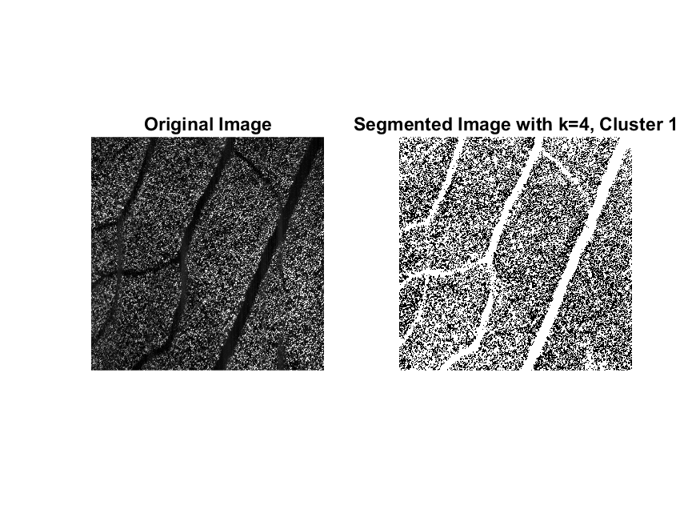
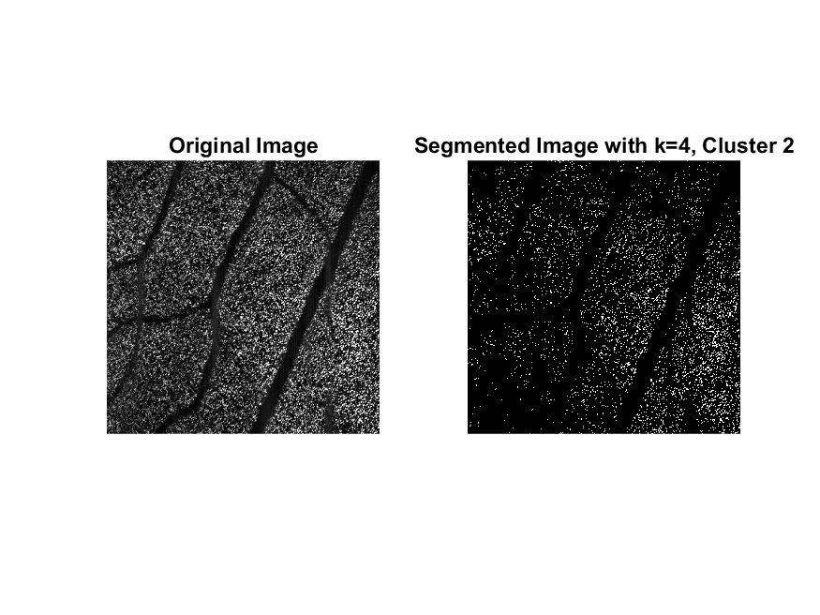
K-means Clustering
Cluster 1
Cluster 2

Slide 13
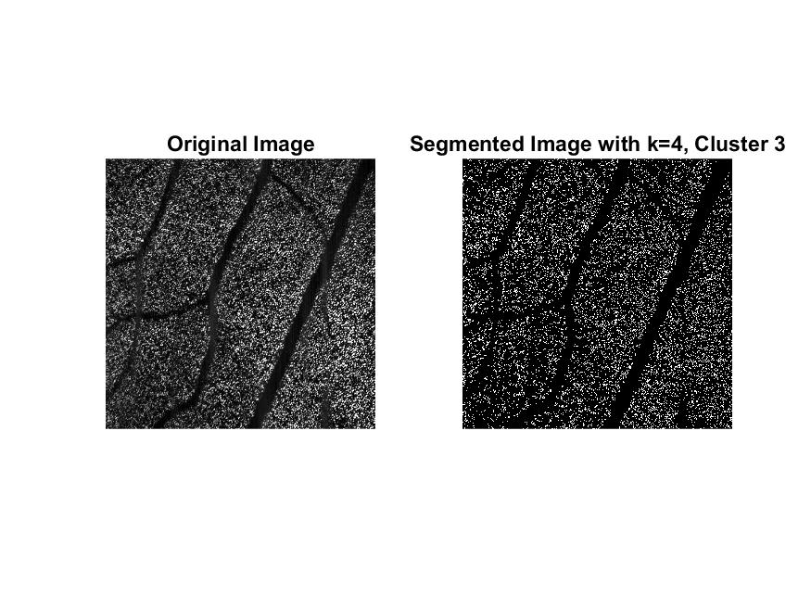
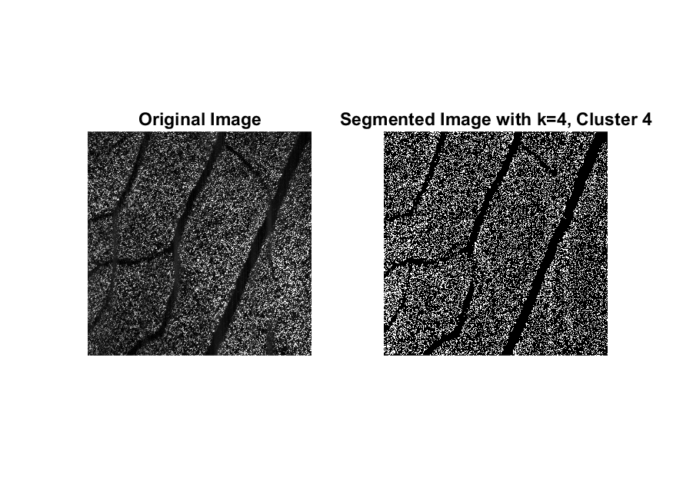
K-means Clustering
Cluster 3
Cluster 4

Slide 14
K-means Clustering (Results)
From k-means clustering, we are able to divide up the image into 4 clusters
From the previous images, Cluster 1 represents the “empty spots” and capillaries
Cluster 2, 3 and 4 represents the photoreceptor cells

Slide 15
K-means Clustering (Results)
A noticeable problem with using MATLAB k-means clustering is the use of the result of randomization of clusters
Even though the results are the same, the clusters produced are never the same
Cluster 1 in one cycle may end up as cluster 2
Problematic if we associate cluster 1 to represent the non-
This problem is because the k-means clustering provided by MATLAB uses a randomized initial clustering using the k-means clustering++.
Solution: use a provided intiail seed

Slide 16
Intensity Segmentation
Intensity Segmentation divides the image into clusters based on intensity value
Problem with this is that marginally differences may end up clustering unrelated objects
This would solve by running k-means clustering after intensity segmentation
Any “wrong” membership would be corrected
This solves the randomized allocation of clustering

Slide 17
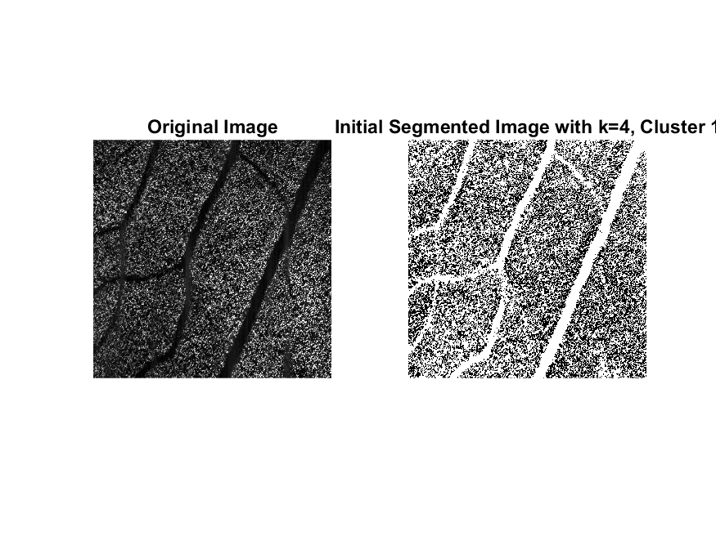
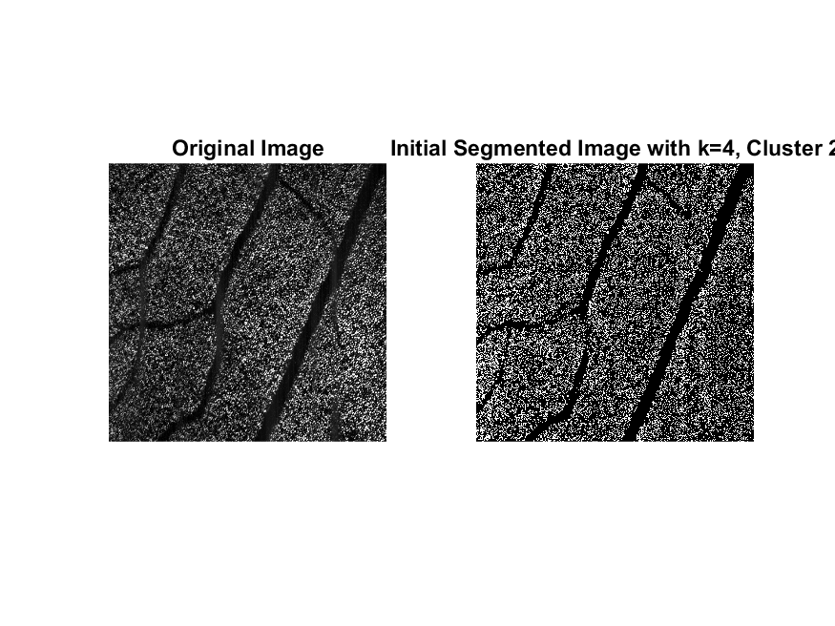
Intensity Segmentation
Cluster 1
Cluster 2

Slide 18
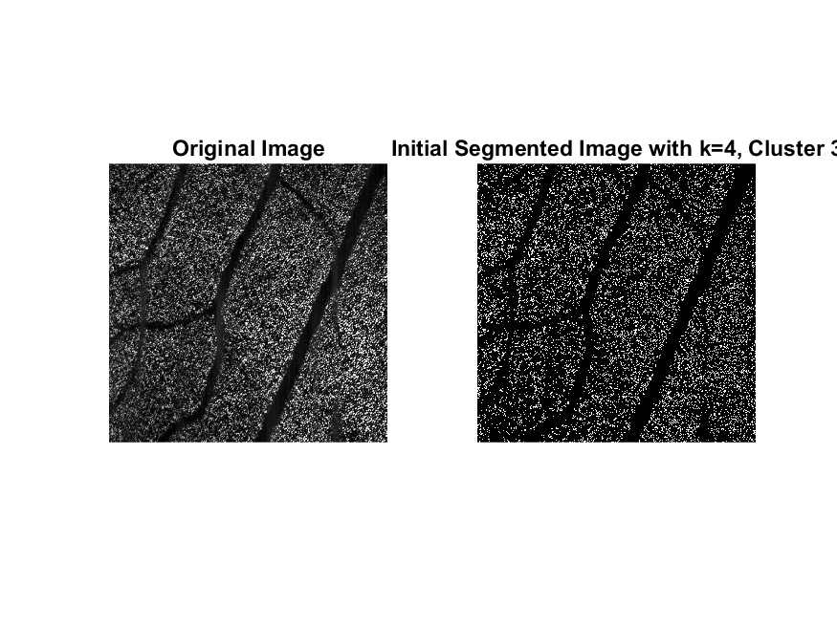

Intensity Segmentation
Cluster 3
Cluster 4

Slide 19

Combined Segmentation
Cluster 1
Cluster 2

Slide 20

Combined Segmentation
Cluster 3
Cluster 4

